Slide 1
微處理機系統 &微處理機系統實習

Slide 2
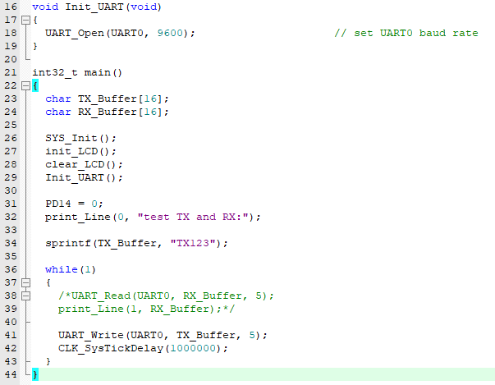
中斷? 輪詢?

Slide 3
t = 0
LED on
t = 1
LED off
t = 2
LED on
t = 3
LED off

Slide 4
t = 0
LED on
CLK_SysTickDelay(10)
LED off
CLK_SysTickDelay(10)
LED on
CLK_SysTickDelay(10)
LED off
CLK_SysTickDelay(10)

Slide 5
t = 0
LED on
CLK_SysTickDelay(1000000)
LED off
CLK_SysTickDelay(1000000)
LED on
CLK_SysTickDelay(1000000)
LED off
CLK_SysTickDelay(1000000)

Slide 6
實作
實作出多事件同時運行
“x-”與“x+”調整led跑馬燈速度（PC12-PC15）
z做出一個可以立即反應的功能，例如：LCD背光（PD14）
試試看如果跑馬燈速度變慢的時候，LCD背光的調整會不會變較不即時? 為什麼?

Slide 7


